Slide 1
Basics of CPP
By
B.Jothi

Slide 2
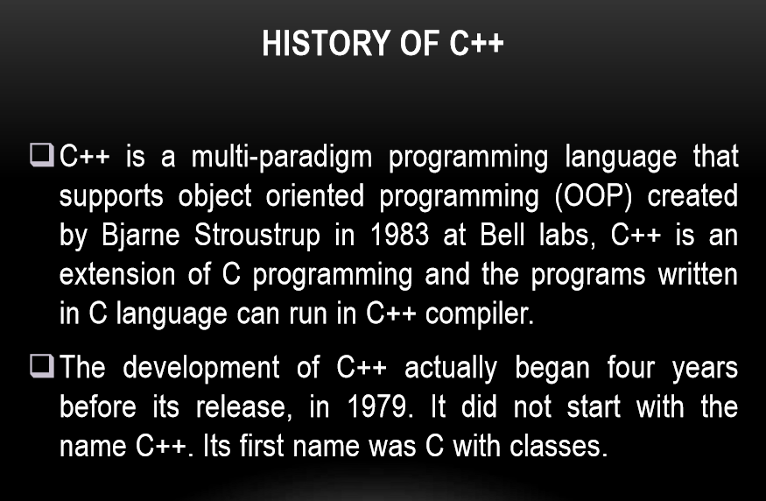

Slide 3
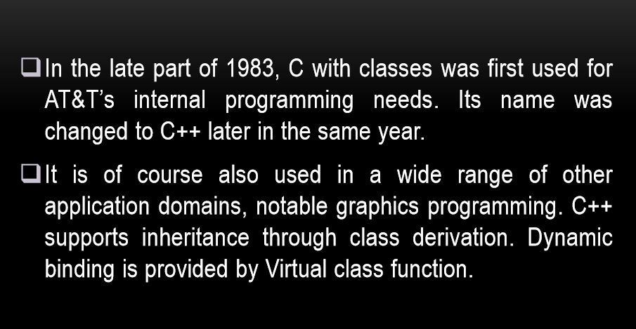

Slide 4
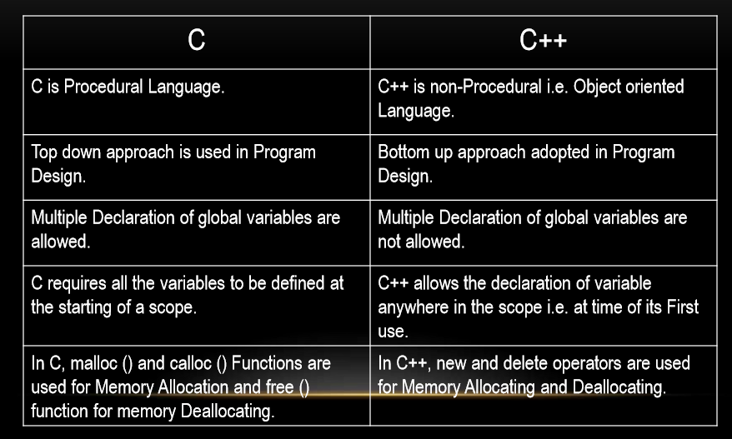
Difference between Cand C++

Slide 5
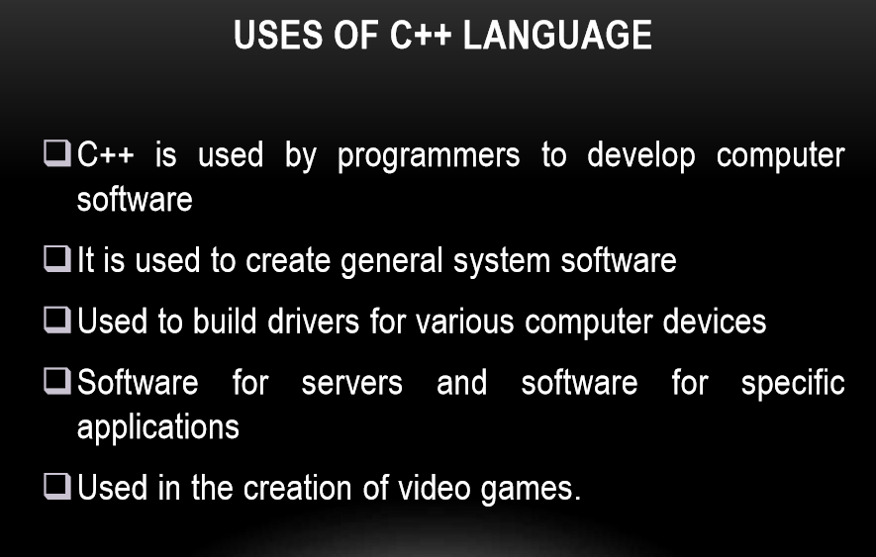

Slide 6
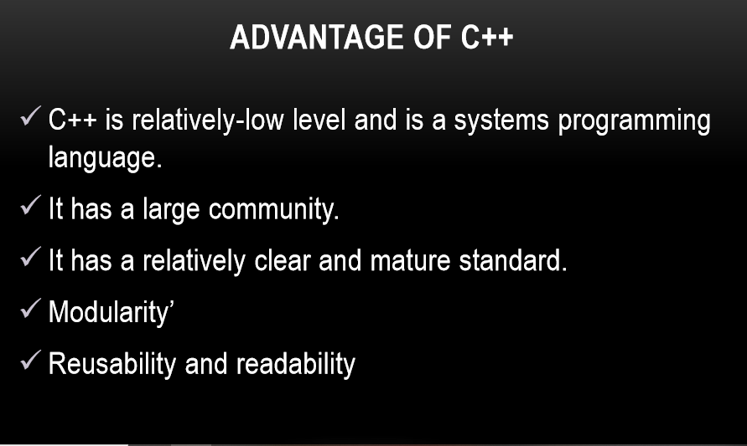

Slide 7
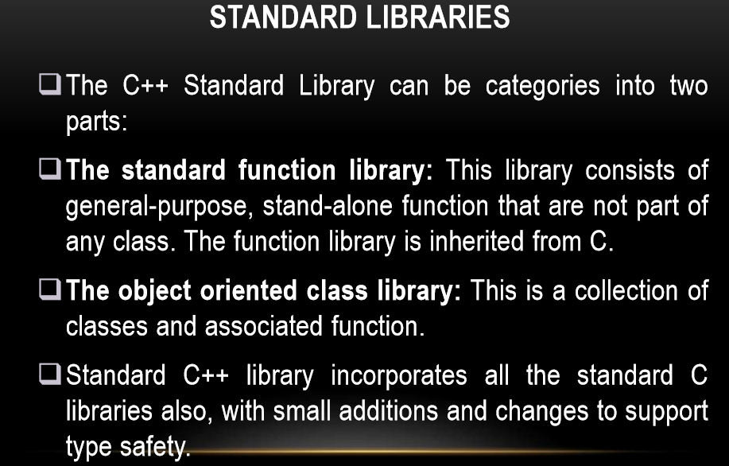

Slide 8
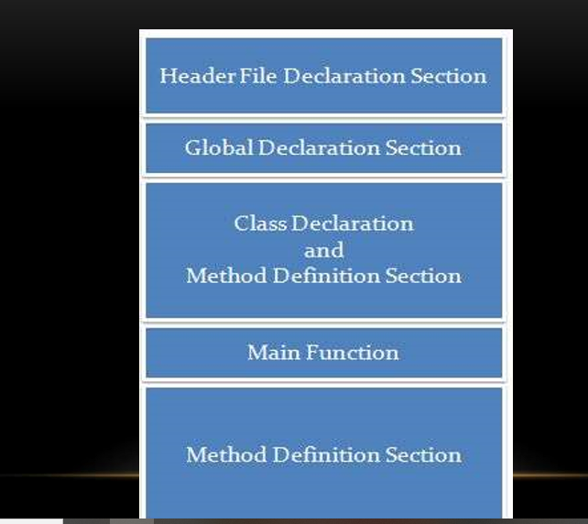
Structure of C++

Slide 9
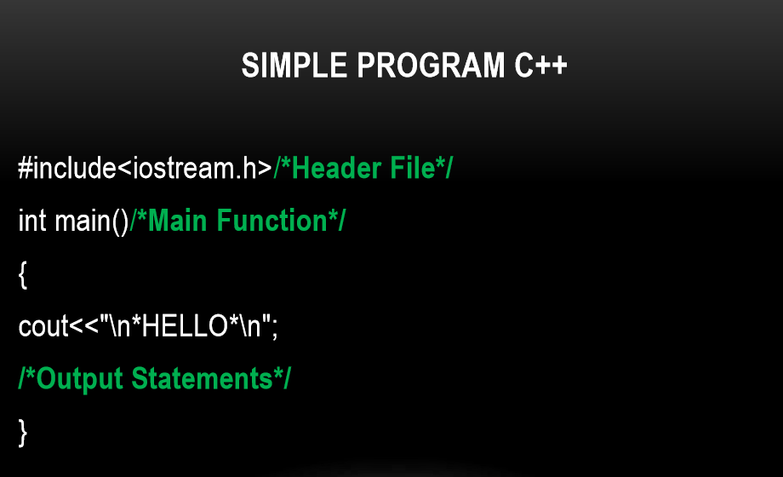

Slide 10
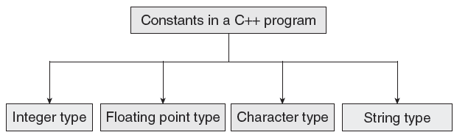
CONSTANTS
Constants are identifiers whose value does not change. While variables can change their value at any time, constants can never change their value.
Constants are used to define fixed values such as Pi or the charge on an electron so that their value does not get changed in the program even by mistake.
A constant is an explicit data value specified by the programmer.
The value of the constant is known to the compiler at the compile time.

Slide 11
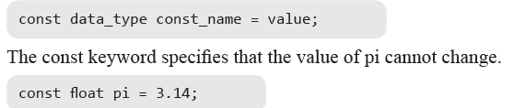
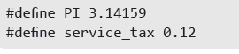
Declaring Constants
Rule 1 Constant names are usually written in capital letters to visually distinguish them from other variable names which are normally written in lower case characters.
Rule 2 No blank spaces are permitted in between the # symbol and define keyword.
Rule 3 Blank space must be used between #define and constant name and between constant name and constant value.
Rule 4 #define is a preprocessor compiler directive and not a statement. Therefore, it does not end with a semi-colon.

Slide 12
Cascading of Input or Output Operators
<< operator –It can use multiple times in the same line.
Its called Cascading
Cout ,Cin can cascaded
For example
cout<<“\n Enter the Marks”;
cin>> ComputerNetworks>>OODP;

Slide 13
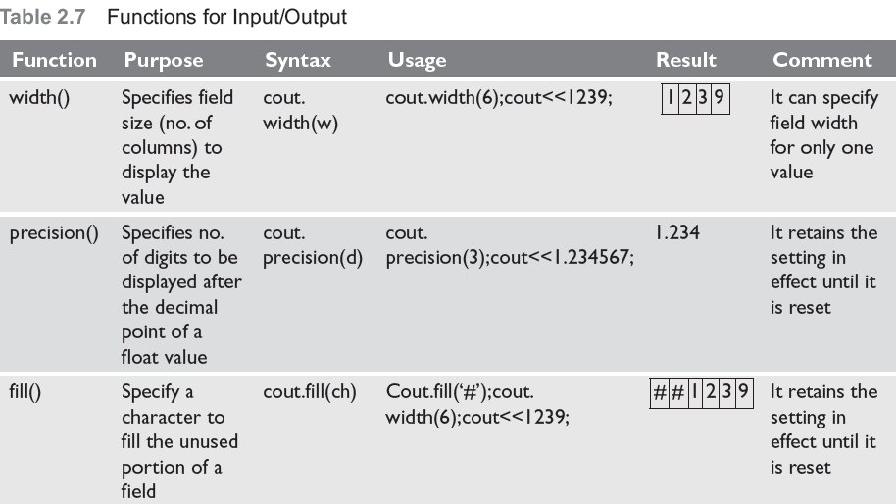
Formatted Input and Output Operations
Formatted I/O
I/O class function and flages
Manipulators
#include<iostream.h>
#define PI 3.14159
main()
{
cout.precision(3);
cout.width(10);
cout.fill(‘*’);
cout<<PI;
Output
*****3.142

Slide 14
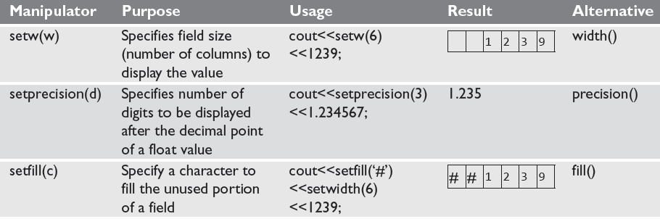
Formatting Output Using Manipulators
C++ has a header file iomanip.h that contains certain manipulators to format the output

Slide 15
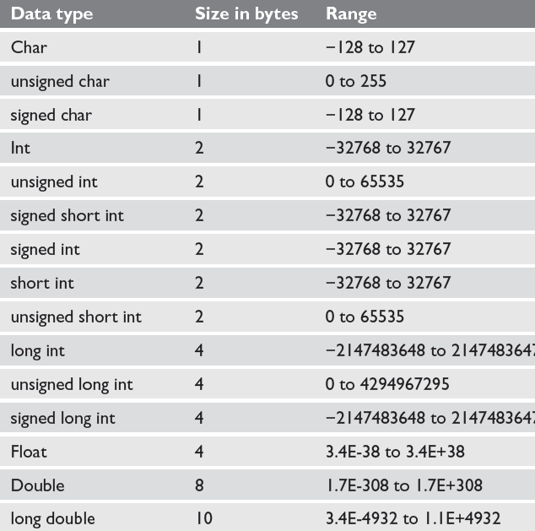
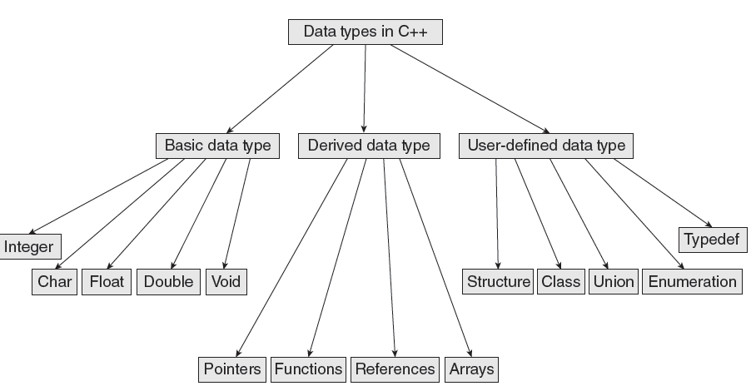
Data Types in C++

Slide 16

Variables
A variable is the content of a memory location that stores a certain value. A variable is identified or denoted by a variable name. The variable name is a sequence of one or more letters, digits or underscore, for example: character_
Rules for defining variable name:
A variable name can have one or more letters or digits or underscore for example character_.
White space, punctuation symbols or other characters are not permitted to denote variable name.
A variable name must begin with a letter.
Variable names cannot be keywords or any reserved words of the C++ programming language.
Data C++ is a case-sensitive language. Variable names written in capital letters differ from variable names with the same name but written in small letters.
01
Local Variables
03
Instance variables
02
Static Variables
04
Final Variables

Slide 17
Variables
Local Variables
Instance Variables
Static Variables
Constant Variables
Local variable: These are the variables which are declared within the method of a class.
Example:
public class Car {
public:
void display(int m){ // Method
int model=m; // Created a local variable model
cout<<model;
}
Instance variable: These are the variables which are declared in a class but outside a method, constructor or any block.
Example:
public class Car {
private: String color;
// Created an instance variable color
Car(String c)
{
color=c;
}}
Static variables: Static variables are also called as class variables. These variables have only one copy that is shared by all the different objects in a class.
Example:
public class Car {
public static int tyres;
// Created a class variable void init(){
tyres=4;
} }
Constant is something that doesn't change. In C language and C++ we use the keyword const to make program elements constant.
Example:
const int i = 10;
void f(const int i)
class Test
{
const int i;
};

Slide 18
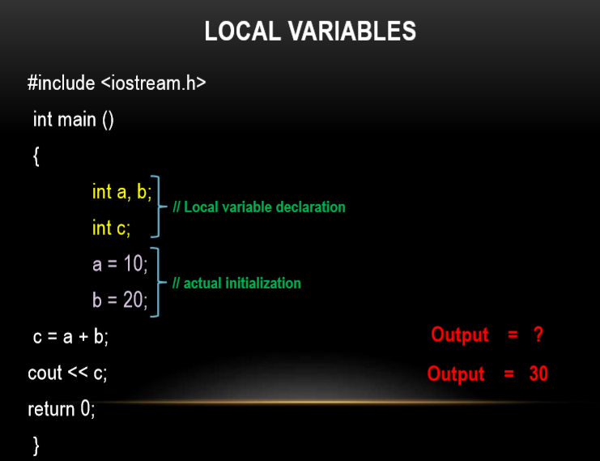

Slide 19
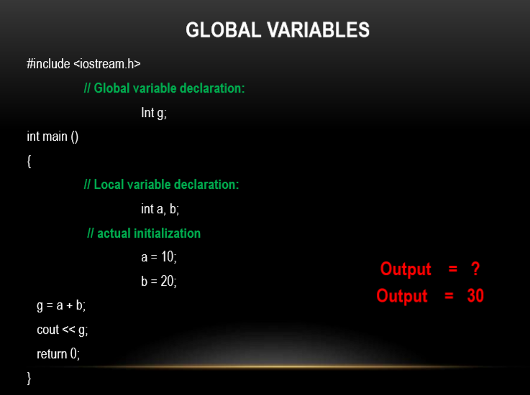

Slide 20
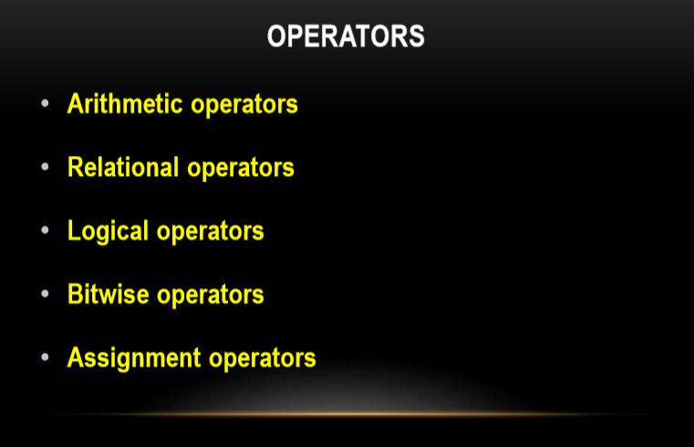

Slide 21
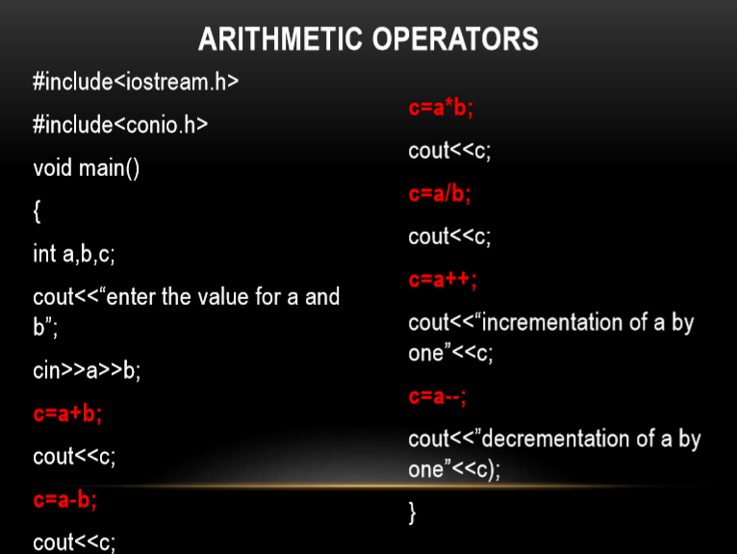

Slide 22
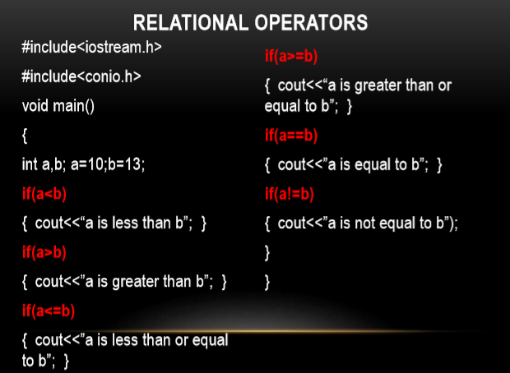

Slide 23
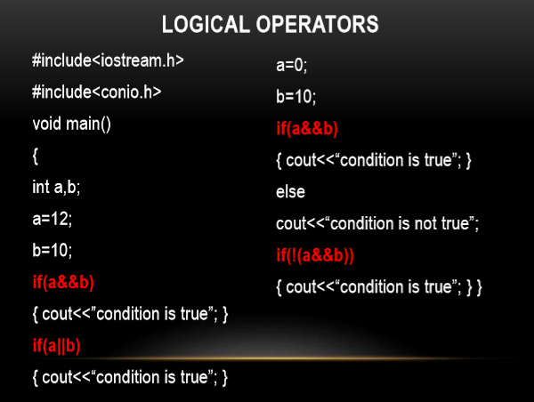

Slide 24
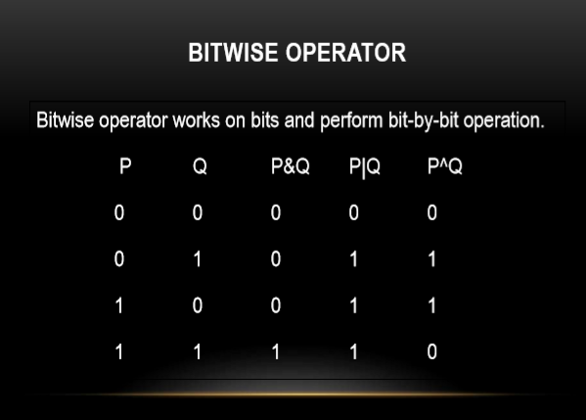

Slide 25
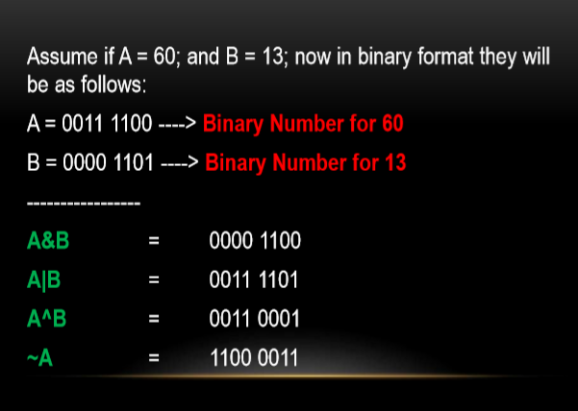

Slide 26
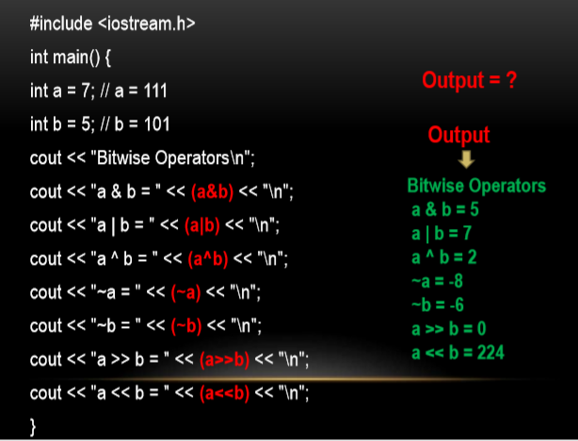

Slide 27
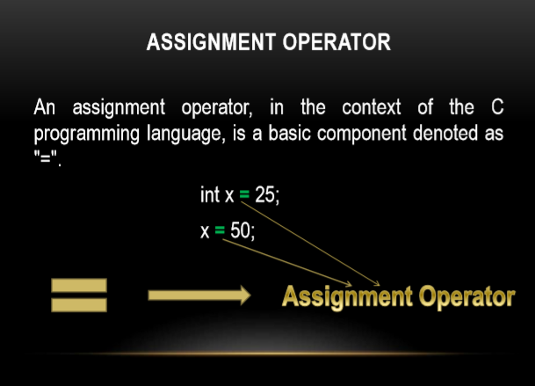

Slide 28
C++ Arrays

Slide 29
Arrays
Used to store a collection of elements (variables)
type array-name[size];
Meaning:
This declares a variable called <array-name> which contains <size> elements of type <type>
The elements of an array can be accessed as: array-name[0],…array-name[size-1]
Example:
int a[100]; //a is a list of 100 integers, a[0], a[1], …a[99]
double b[50];
char c[10];

Slide 30
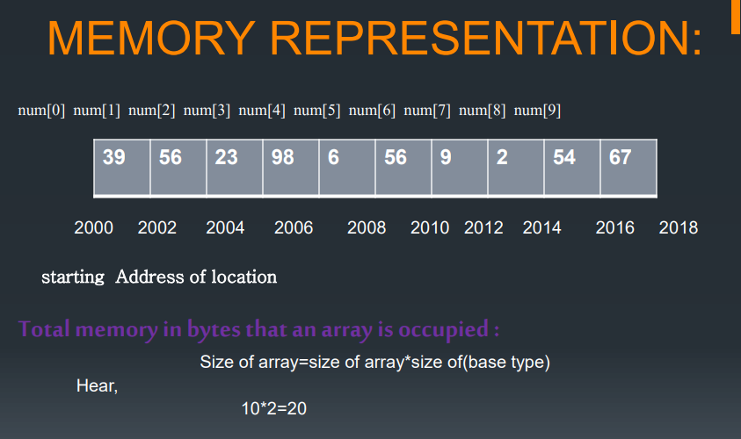
Memory representation

Slide 31
Array example
//Read 100 numbers from the user
#include <iostream.h>
void main() {
int i, a[100], n;
i=0; n=100;
while (i<n) {
cout << “Input element “ << i << “: ”;
cin >> a[i];
i = i+1;
}
//do somehing with it ..
}

Slide 32
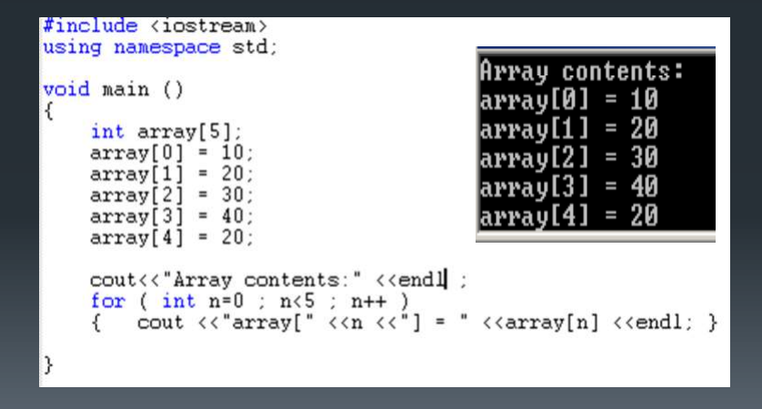
Example

Slide 33
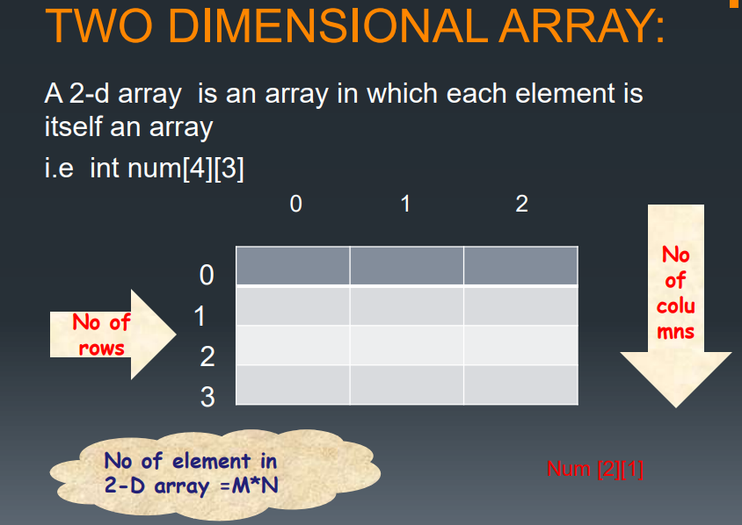
Two dimensional array

Slide 34
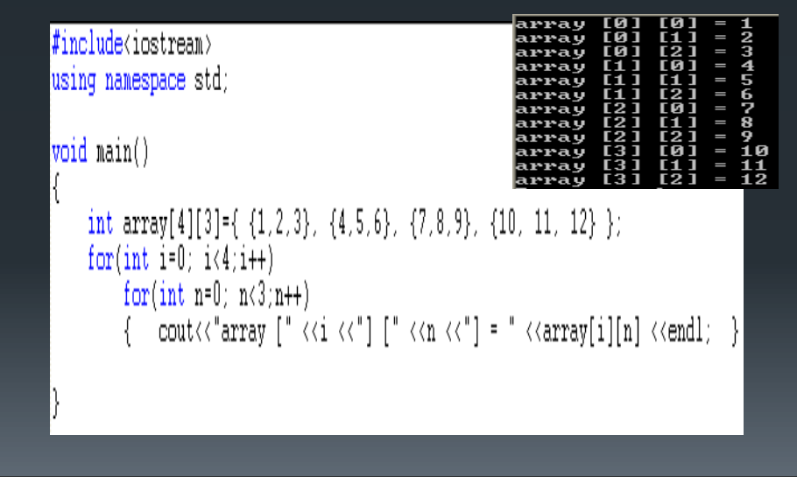
Example

Slide 35
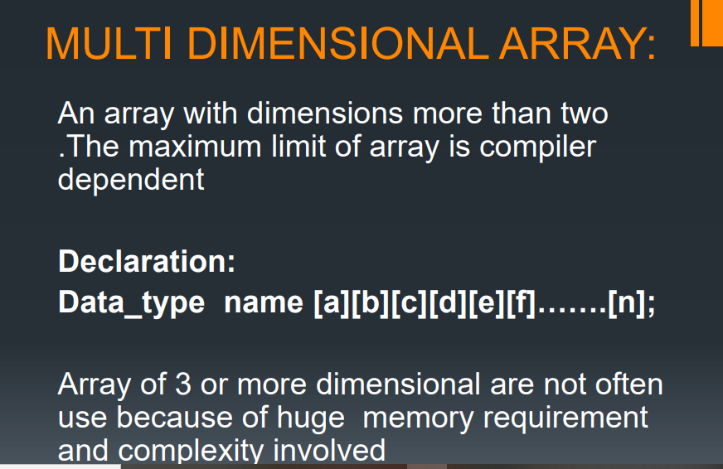

Slide 36
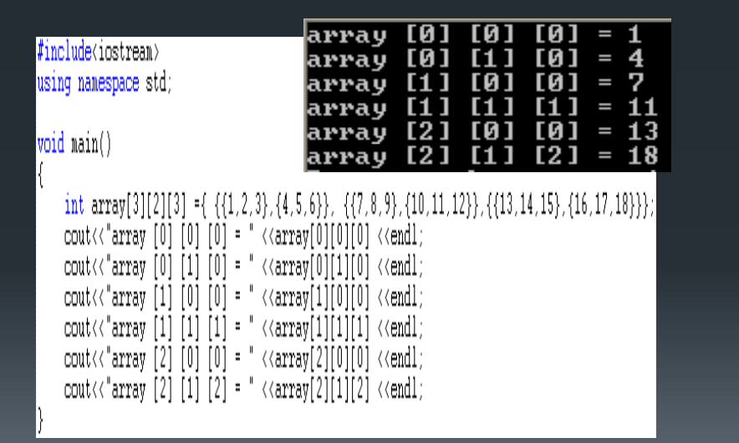

Slide 37
Problems
Write a C++ program to read a sequence of (non-negative) integers from the user ending with a negative integer and write out
the average of the numbers
the smallest number
the largest number
the range of the numbers (largest - smallest)
Example:
The user enters: 3, 1, 55, 89, 23, 45, -1
Your program should compute the average of {3, 1, 55, 89, 23, 45} etc

Slide 38
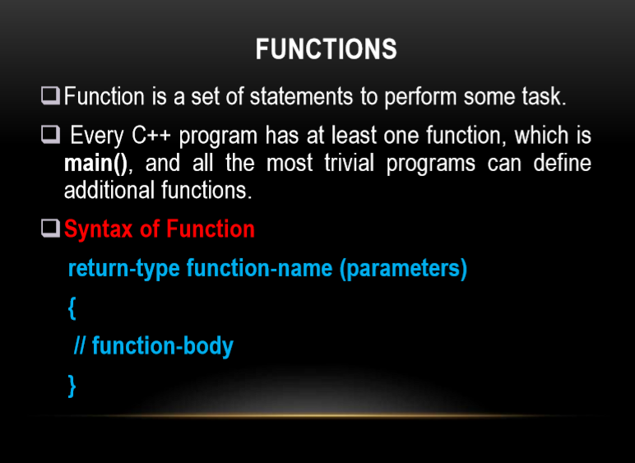

Slide 39
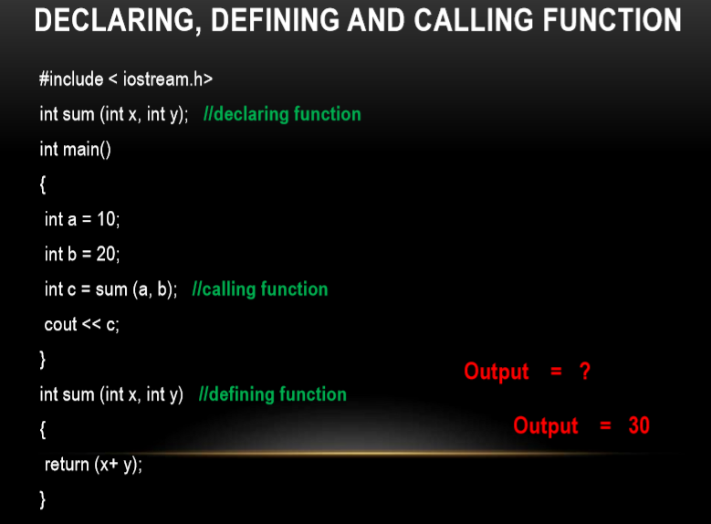

Slide 40
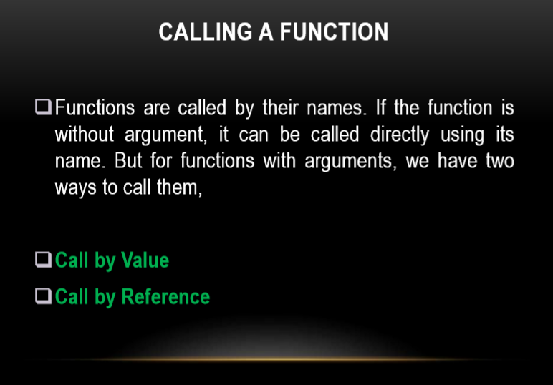

Slide 41
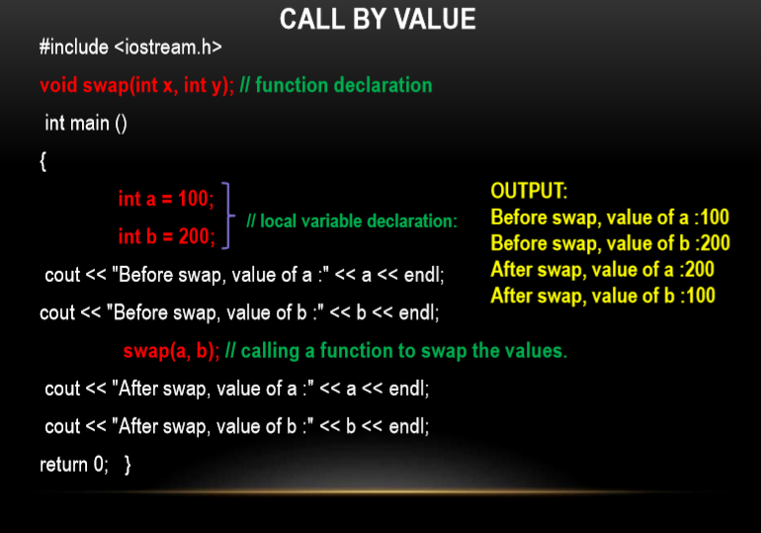

Slide 42
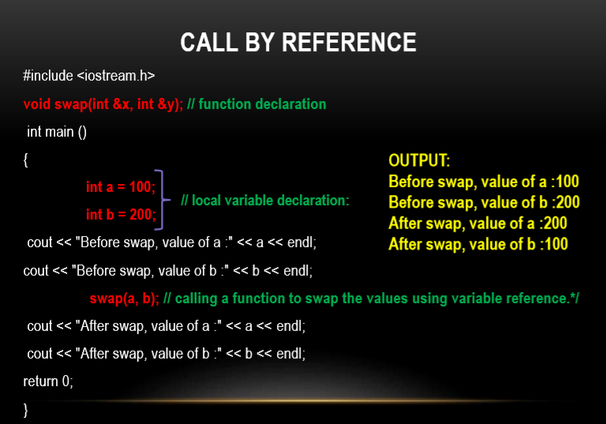

Slide 43
Pointers
Pointer is variable in C++
It holds the address of another variable
Syntax data_type *pointer_variable;
Example int *p,sum;
Assignment
To assign the address of variable to pointer-ampersand symbol (&)
p=&sum;
integer type pointer can hold the address of another int variable
P=&sum;//assign address of another variable
cout<<&sum; //to print the address of variable
cout<<p;//print the value of variable

Slide 44
How to use it
Example of pointer
#include<iostream.h>
using namespace std;
int main()
{ int *p,sum=10;
p=&sum;
cout<<“Address of sum:”<<&sum<<endl;
cout<<“Address of sum:”<<p<<endl;
cou<<“Address of p:”<<&p<<endl;
cout<<“Value of sum”<<*p;
}
Output:
Address of sum : 0X77712
Address of sum: 0x77712
Address of p: 0x77717
Value of sum: 10

Slide 45
Pointers and Arrays
assigning the address of array to pointer don’t use ampersand sign(&)
#include <iostream>
using namespace std;
int main(){
//Pointer declaration
int *p;
//Array declaration
int arr[]={1, 2, 3, 4, 5, 6};
//Assignment
p = arr;
for(int i=0; i<6;i++){
cout<<*p<<endl;
//++ moves the pointer to next int position
p++;
}
return 0;
}
OUTPUT:
0
1
2
3
4
5
6

Slide 46
This Pointers
this pointer hold the adderss of current object
int num;
This->num=num;

Slide 47
Function using pointers
#include<iostream>
using namespace std;
void swap(int *a ,int *b );
//Call By Reference
int main()
{
int p,q;
cout<<"\nEnter Two Number You Want To Swap \n";
cin>>p>>q;
swap(&p,&q);
cout<<"\nAfter Swapping Numbers Are Given below\n\n";
cout<<p<<" "<<q<<" \n";
return 0;
}
void swap(int *a,int *b)
{
int c;
c=*a;
*a=*b;
*b=c;
}
Output:
Enter Two Number You Want to Swap
10 20
After Swapping Numbers Are Given below
20 10

Slide 48
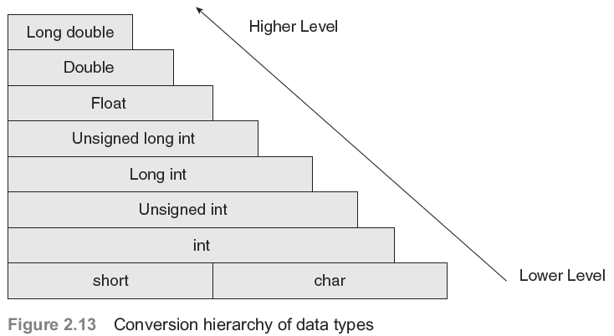
Type conversion and type casting
Type conversion or typecasting of variables refers to changing a variable of one data type into another. While type conversion is done implicitly, casting has to be done explicitly by the programmer.

Slide 49
Type Casting
Type casting an arithmetic expression tells the compiler to represent the value of the expression in a certain format.
It is done when the value of a higher data type has to be converted into the value of a lower data type.
However, this cast is under the programmer’s control and not under the compiler’s control. The general syntax for type casting is destination_variable_name=destination_data_ty--pe(source_variable_name);
float sal=10000.00;
int income;
Income=int(sal);

Slide 50
Class and objects

Slide 51
Class:
Class is a user defined data type,
It holds its own data members and member functions,
It can be accessed and used by creating instance of that class.
The variables inside class definition are called as data members and
the functions are called member functions

Slide 52
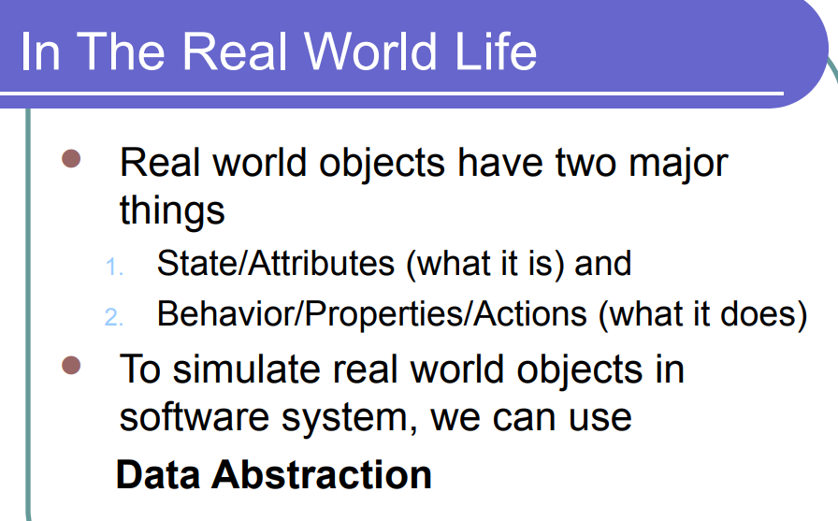
Class:
Class is a user defined data type,
It holds its own data members and member functions,
It can be accessed and used by creating instance of that class.
The variables inside class definition are called as data members and
the functions are called member functions

Slide 53
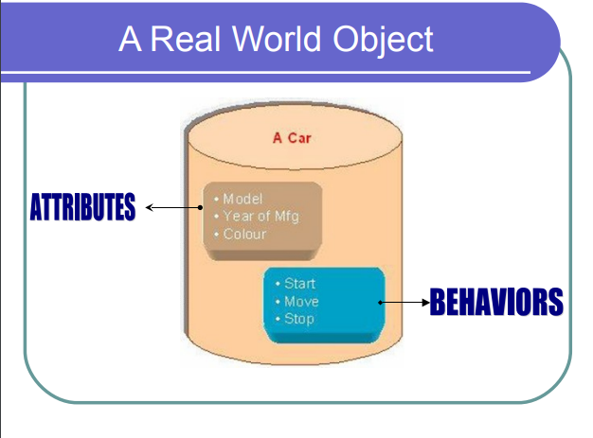

Slide 54
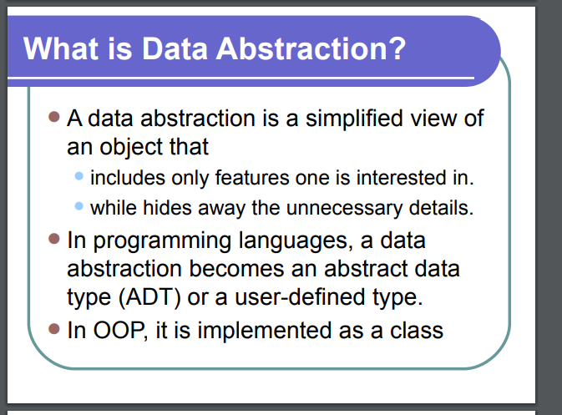

Slide 55
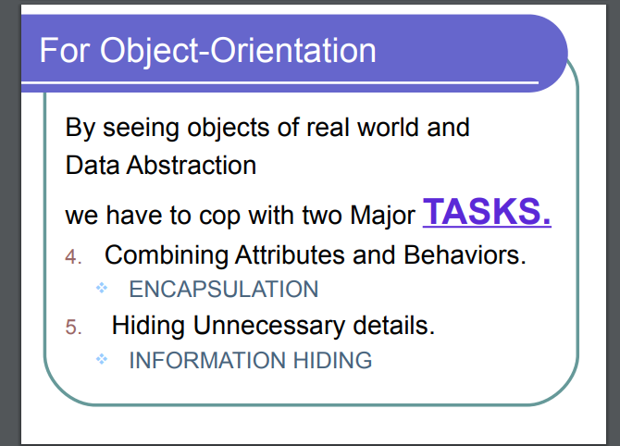

Slide 56
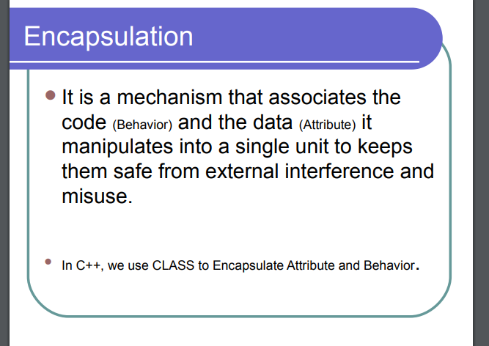

Slide 57
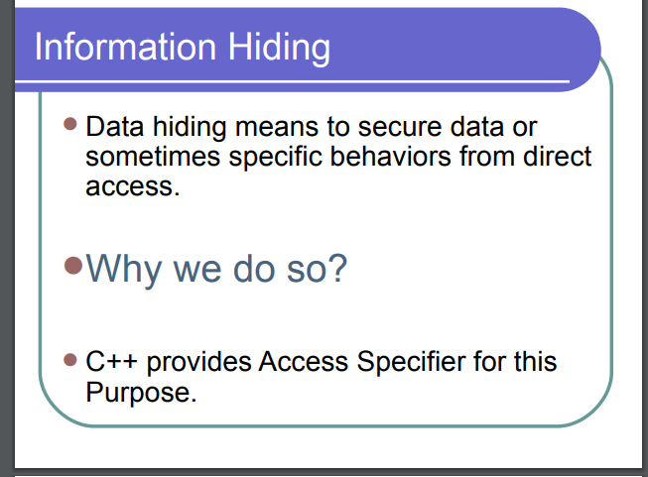

Slide 58
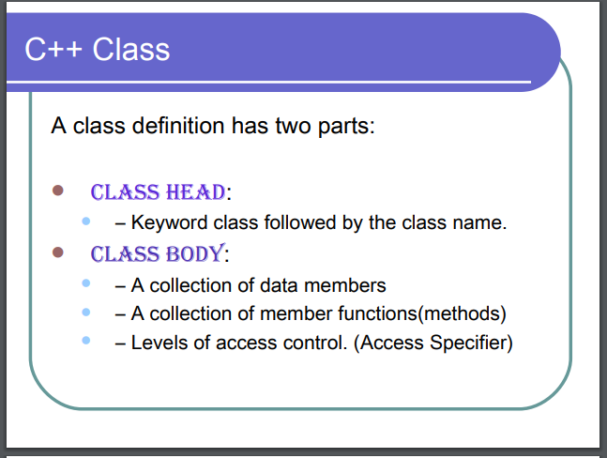

Slide 59
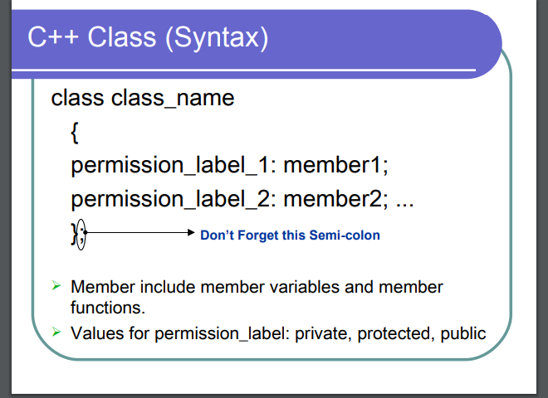

Slide 60
Define a Class Type
Syntax:
Name of the class
Example:
class Class_name
{
permission_label:
member;
permission_label:
member;
...
};
class Rectangle
{
private:
int width;
int length;
public:
void set(int w, int l);
int area();
};
keyword
Body

Slide 61
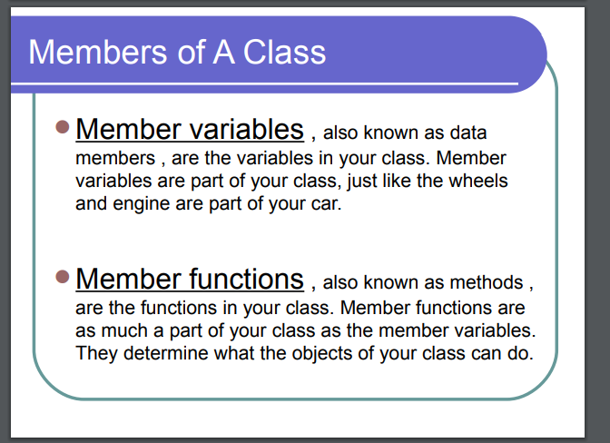

Slide 62
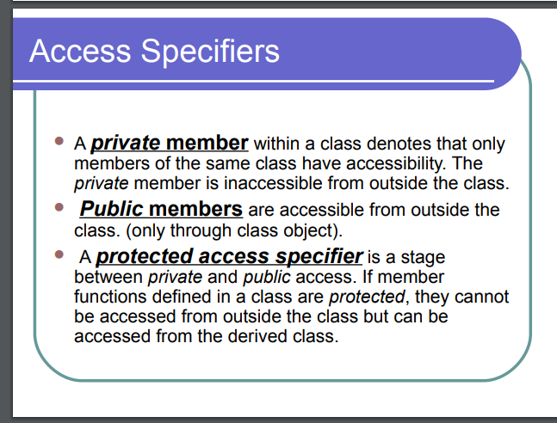

Slide 63
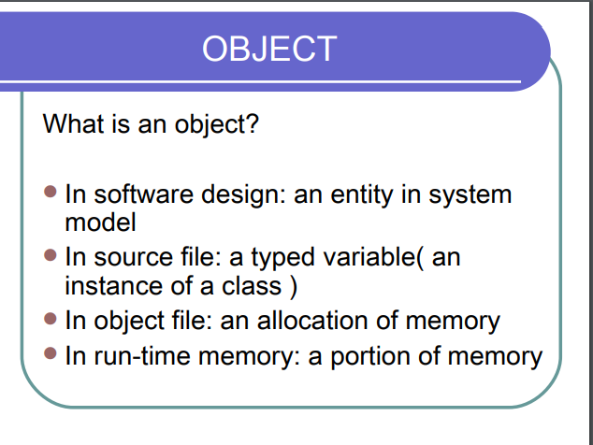

Slide 64
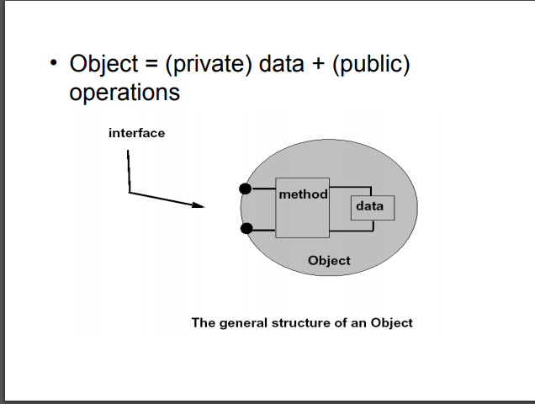
Object creation

Slide 65
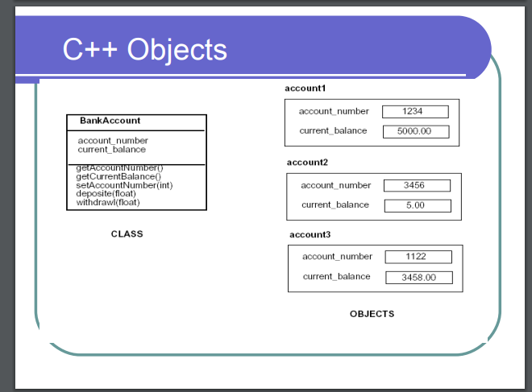
Example for objects

Slide 66


Slide 67


Slide 68
- Data members Can be of any type, built-in or user-defined.
This may be,
non-static data member
Each class object has its own copy
static data member
Acts as a global variable

Slide 69
Static data member is declared using the static keyword.
There is only one copy of the static data member in the class. All the objects share the static data member.
The static data member is always initialized to zero when the first class object is created.
Syntax:
static data_type datamember_name;
Here
static is the keyword.
data_type – int , float etc…
datamember_name – user defined

Slide 70
Static Data Member
class Rectangle
{
private:
int width;
int length;
static int count;
public:
void set(int w, int l);
int area();
}
Rectangle r1;
Rectangle r2;
Rectangle r3;
count
r1
r2
width
length
width
length
width
length
r3

Slide 71
- Data members Can be of any type, built-in or user-defined.
This may be,
non-static data member
Each class object has its own copy
static data member
Acts as a global variable

Slide 72
Static data member is declared using the static keyword.
There is only one copy of the static data member in the class. All the objects share the static data member.
The static data member is always initialized to zero when the first class object is created.
Syntax:
static data_type datamember_name;
Here
static is the keyword.
data_type – int , float etc…
datamember_name – user defined

Slide 73
Static Data Member
class Rectangle
{
private:
int width;
int length;
static int count;
public:
void set(int w, int l);
int area();
}
Rectangle r1;
Rectangle r2;
Rectangle r3;
count
r1
r2
width
length
width
length
width
length
r3

Slide 74
Example program for static
#include <iostream>
using namespace std;
void Test(){
static int x = 1;
x = ++x;
int y = 1;
y = ++y;
cout<<"x = "<<x<<"n";
cout<<"y = "<<y<<"n";
}
int main()
{
Test();
Test();
return 0;
}

Slide 75
Static Member Functions in C++
Properties of static member functions:
A static function can only access other static variables or functions present in the same class
Static member functions are called using the class name. Syntax- class_name::function_name( )

Slide 76
Example for static member
#include <iostream>
using namespace std;
class Example{
static int Number;
int n;
public:
void set_n(){
n = ++Number;
}
void show_n(){
cout<<"value of n = "<<n<<endl;
}
static void show_Number(){
cout<<"value of Number = "<<Number<<endl;
}
};
int Example:: Number;
Int main()
{
Example example1, example2;
example1.set_n();
example2.set_n();
example1.show_n();
example2.show_n();
Example::show_Number();
return 0;
}

Slide 77
Use case diagram

Slide 78
Definition:
A diagram that shows a set of use cases and actors and their relationships. Use cases represent system functionality, the requirements of the system from the user’s perspective.

Slide 79

Notations
use case
A description of a set of sequences of actions, including variants, that system performs that yields an observable value to an actor.

Slide 80

Notations
actor
The people or systems that provide or receive information from the system; they are among the stakeholders of a system.

Slide 81

Notations
include
Specifies that the source use case explicitly incorporates the behaviour of another use case at a location specified by the source

Slide 82

Notations
extend Specifies that the target use case extends the behaviour of the source.

Slide 83

Actors

Slide 84

Actors

Slide 85
Use Case Diagram – Guidelines & Caution
1.Use cases should ideally begin with a verb – i.e generate report. Use cases should NOT be open ended – i.e Register (instead should be named as Register New User)
2. Avoid showing communication between actors.
3. Actors should be named as singular. i.e student and NOT students. NO names should be used – i.e John, Sam, etc.
4. Do NOT show behaviour in a use case diagram; instead only depict only system functionality.
5. Use case diagram does not show sequence – unlike DFDs

Slide 86

Example – Include and Extend

Slide 87
Draw a use case diagram for the scenario below:
Inventory System
In order to generate an invoice a clerk must log in. If a clerk is a first time user, one must have themselves registered. There should be an option for a user to register oneself within the login page. Any user can use the system to view products online. The option of login is also provided when a user views products online.

Slide 88

Exercise - Solution

Slide 89

Use case diagram

Slide 90
Constructors
Constructors are special class functions which performs initialization of every object.
The Compiler calls the Constructor whenever an object is created.
Constructors initialize values to object members after storage is allocated to the object.

Slide 91

Rules of defining a constructor

Slide 92

Example for constructor

Slide 93
Destructors in C++
Destructor is a special class function which destroys the object as soon as the scope of object ends.
The destructor is called automatically by the compiler when the object goes out of scope.

Slide 94

Example for destructor

Slide 95

Class Diagram

Slide 96


Slide 97


Slide 98


Slide 99


Slide 100

UML Representation of Class

Slide 101


Slide 102


Slide 103
Relationships among Classes
Represents a connection between multiple classes or a class and itself
3 basic categories:
association relationships
generalization relationships
aggregation relationships

Slide 104

Association Relationship
A bidirectional semantic connection between classes
Name of relationship type shown by:
drawing line between classes
labeling with the name of the relationship
indicating with a small solid triangle beside the name of the relationship the direction of the association

Slide 105

Role type shown by:
drawing line between classes
indicating with a plus sign before the role name

Slide 106
Generalization Relationship
Enables the analyst to create classes that inherit attributes and operations of other classes
Represented by a-kind-of relationship

Slide 107

Generalization Relationship

Slide 108

Generalization Relationship

Slide 109

Aggregation Relationship
Specialized form of association in which a whole is related to its part(s)
Represented by a-part-of relationship
Denoted by placing a diamond nearest the class representing the aggregation

Slide 110

Multiplicity
Documents how many instances of a class can be associated with one instance of another class

Slide 111
Multiplicity
Denotes the minimum number.. maximum number of instances
Exactly one 1
Zero or more 0..* or 0..m
One or more 1..* or 1..m
Zero or one 0..1
Specified range 2..4
Multiple, disjoint ranges 1..3, 5

Slide 112
Guidelines for Analyzing Use Cases (2)
An adjective implies an attribute of an object
A doing verb implies an operation
A being verb implies a relationship between an object and its class
A having verb implies an aggregation or association relationship
Notes:
Class diagram
Examine the text to identify potential objects, attributes, operations, and relationships

Slide 113
Guidelines for Analyzing Use Cases (3)
A transitive verb implies an operation
An intransitive verb implies an exception
A predicate or descriptive verb phrase implies an operation
An adverb implies an attribute of a relationship or an operation
Notes:
Transitive Verb
The meaning of a transitive verb is incomplete without a direct object, as in the following examples:
INCOMPLETE COMPLETE
The shelf holds. The shelf holds three
books and a vase of
flowers.
The committee named. The committee named a
new chairperson.
The child broke. The child broke the plate.
Intransitive Verb
An intransitive verb, on the other hand, cannot take a direct object.
Example: This plant has thrived on the south windowsill.
Predicate
part of the sentence that contains a verb or verb phrase and its complements

Slide 114
Class Diagram
Ensure that the classes are both necessary and sufficient to solve the underlying problem
no missing attributes or methods in each class
no extra or unused attributes or methods in each class
no missing or extra classes
Notes:
Constraints
Example of constraint: attribute that can only be within a certain range
Look at the pre-conditions and post-conditions in the use cases
Decide how to handle violations to the constraints (how to handle errors/exceptions)

Slide 115


Slide 116


